Slide 1
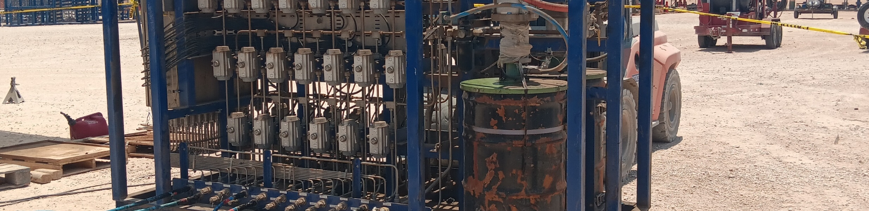
Valve Health Tracker Corey Ray Devi Sai Shreyas Yakama Diego Garziera Volpato Hackathon 2023

Slide 2
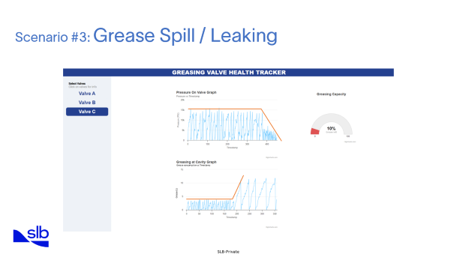
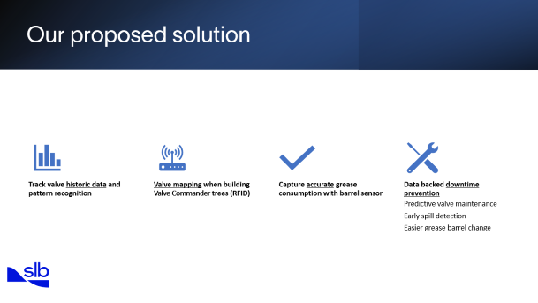
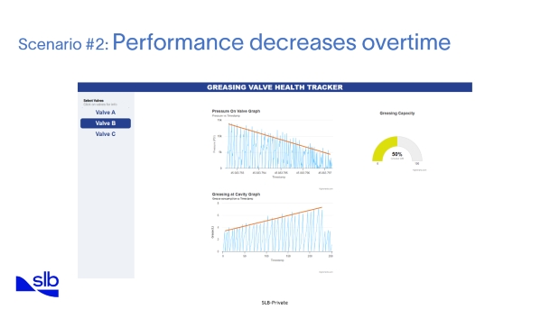
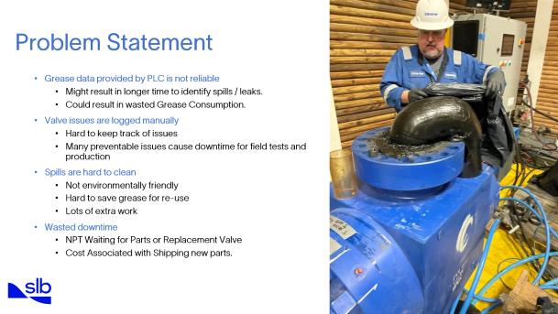
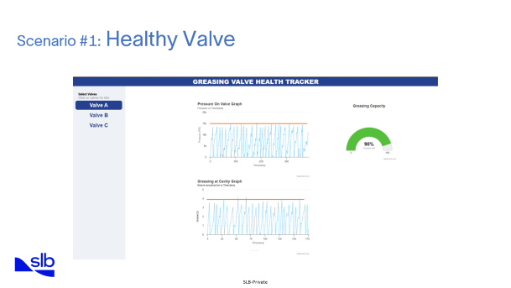

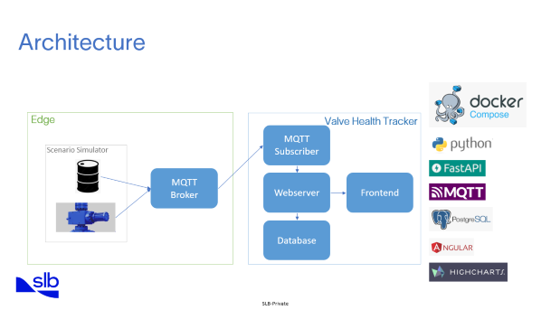
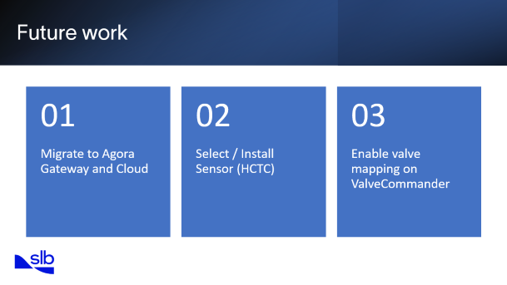
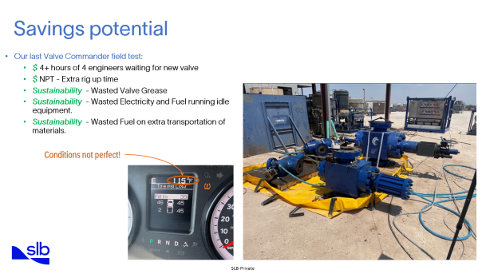
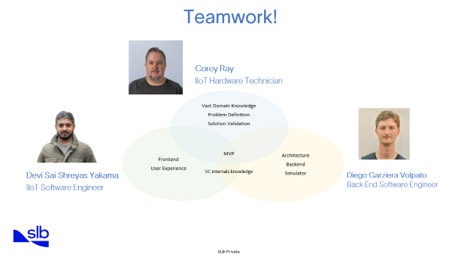
Summary

Slide 3
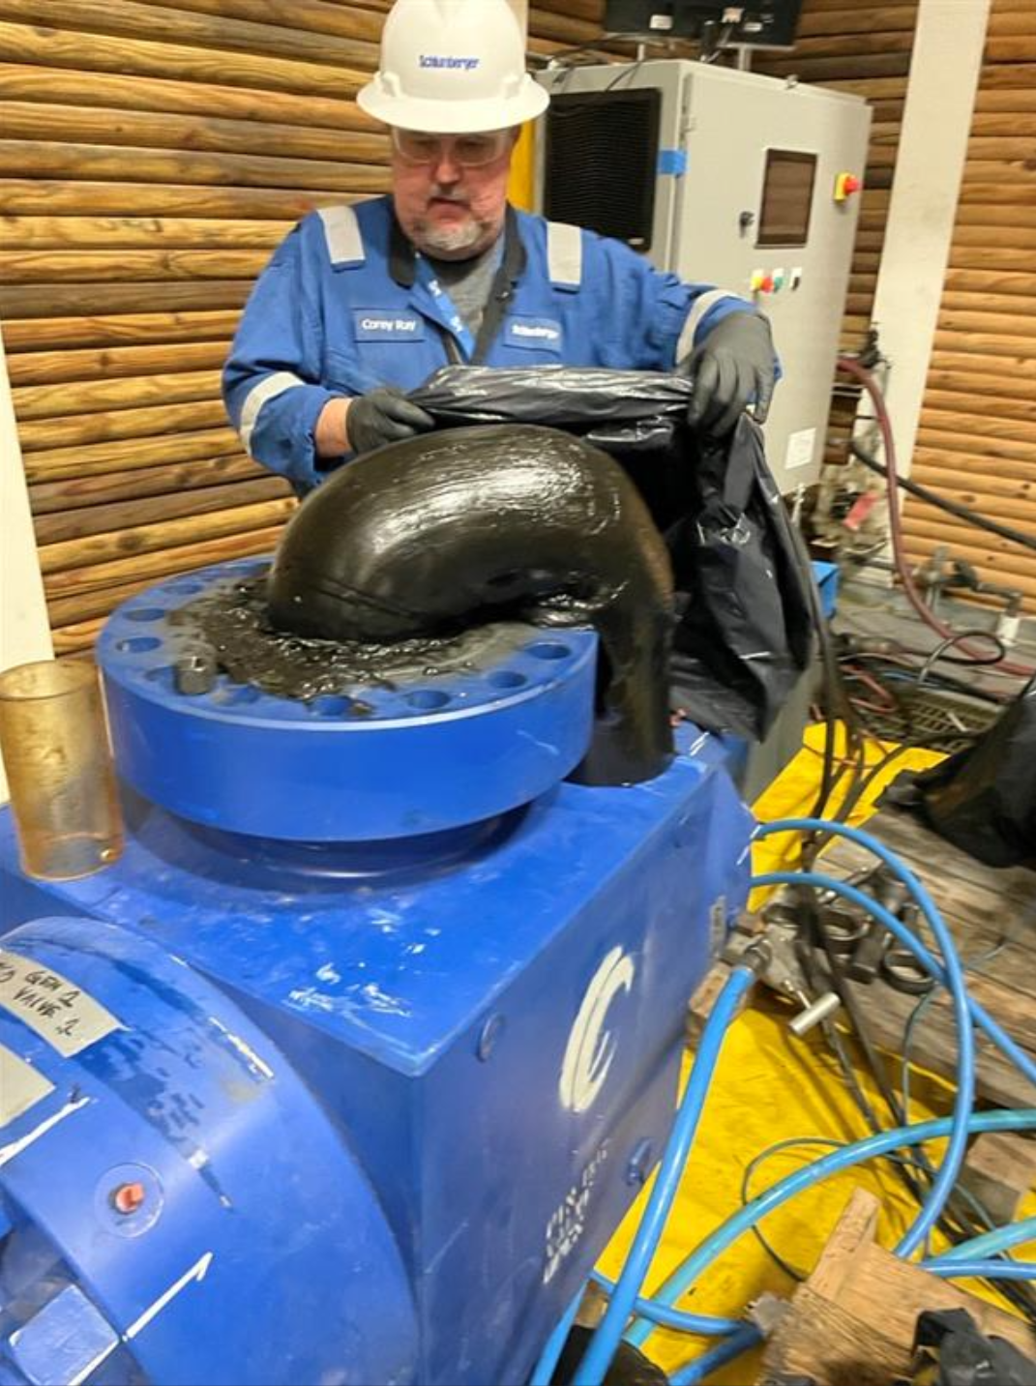

Problem Statement
Grease data provided by PLC is not reliable
Might result in longer time to identify spills / leaks.
Could result in wasted Grease Consumption.
Valve issues are logged manually
Hard to keep track of issues
Many preventable issues cause downtime for field tests and production
Spills are hard to clean
Not environmentally friendly
Hard to save grease for re-use
Lots of extra work
Wasted downtime
NPT Waiting for Parts or Replacement Valve
Cost Associated with Shipping new parts.

Slide 4
Our proposed solution
Track valve historic data and pattern recognition
Valve mapping when building Valve Commander trees (RFID)
Capture accurate grease consumption with barrel sensor
Data backed downtime prevention
Predictive valve maintenance
Early spill detection
Easier grease barrel change

Slide 5
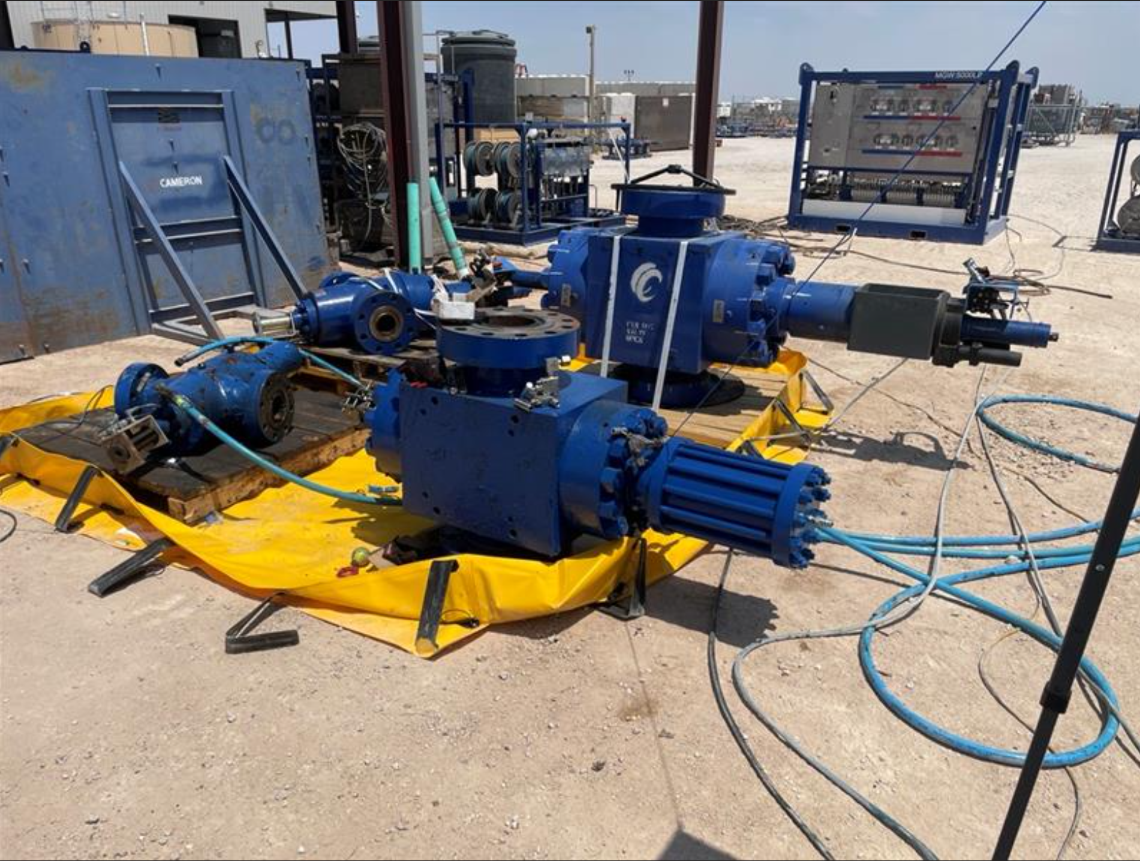
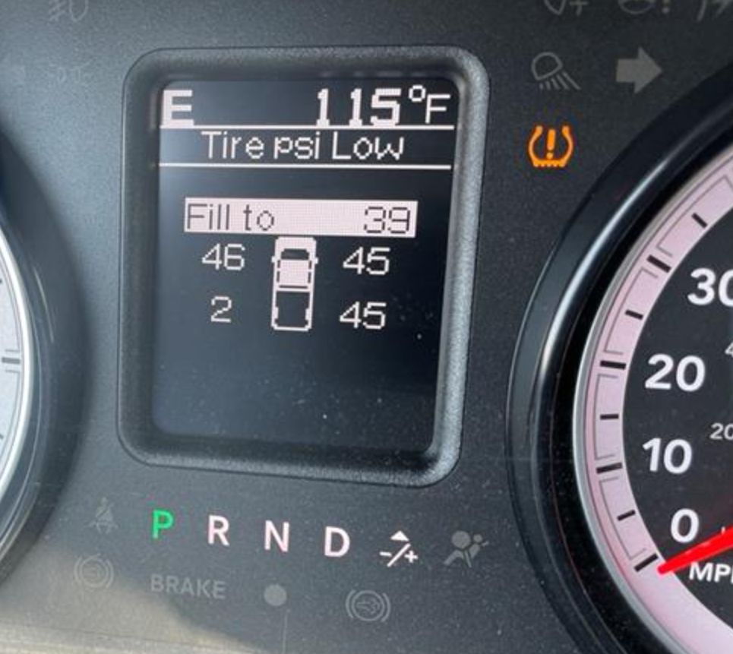
Savings potential
Our last Valve Commander field test:
$ 4+ hours of 4 engineers waiting for new valve
$ NPT - Extra rig up time
Sustainability - Wasted Valve Grease
Sustainability - Wasted Electricity and Fuel running idle equipment.
Sustainability - Wasted Fuel on extra transportation of materials.
Conditions not perfect!

Slide 6









Architecture
Edge
Valve Health Tracker
MQTT Subscriber
Scenario Simulator
MQTT Broker
Webserver
Frontend
Database

Slide 7
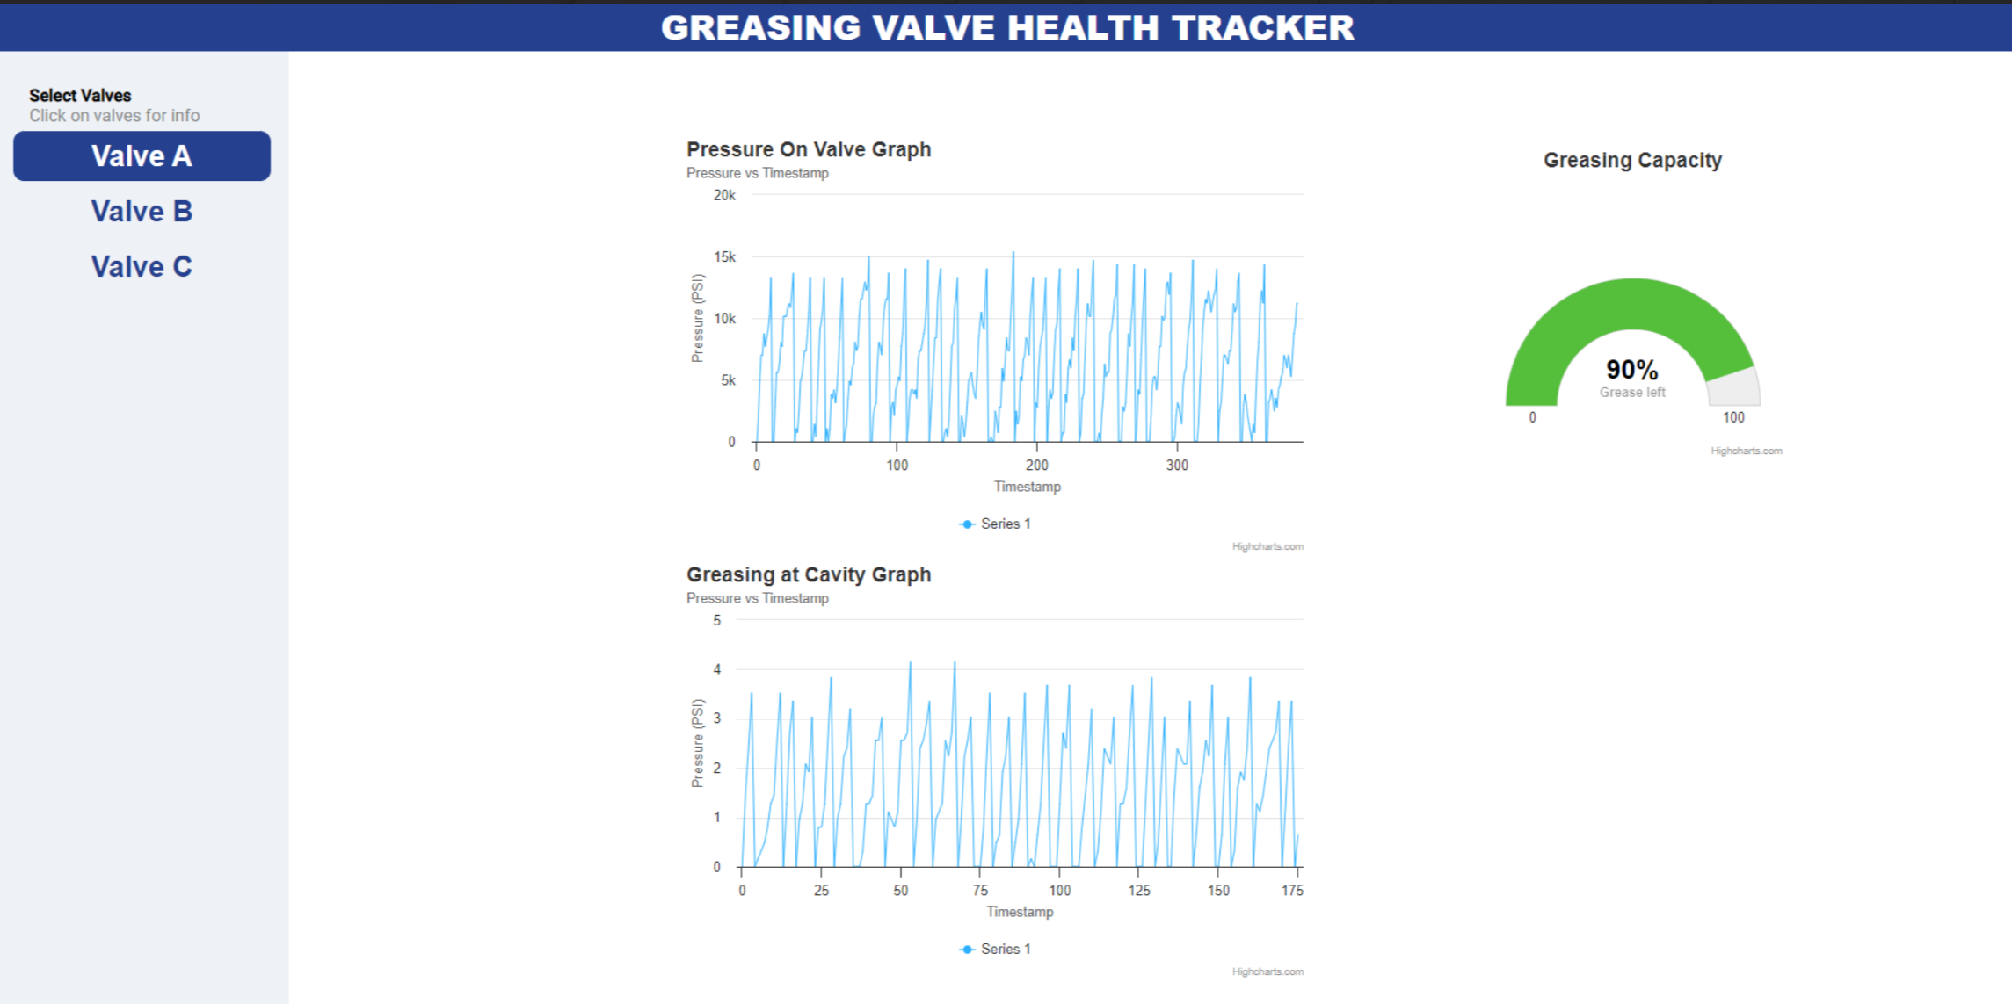
Scenario #1: Healthy Valve
Grease consumption vs Timestamp
Grease (L)

Slide 8
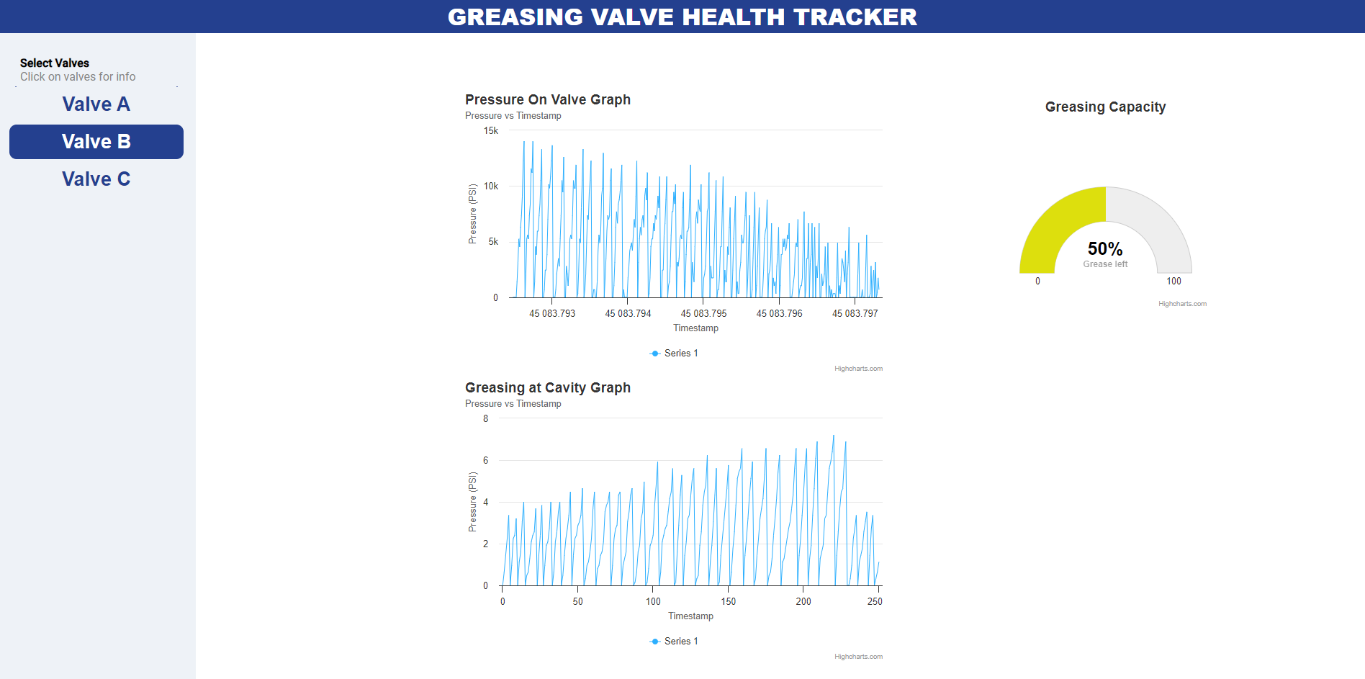
Scenario #2: Performance decreases overtime
Grease consumption vs Timestamp
Grease (L)

Slide 9
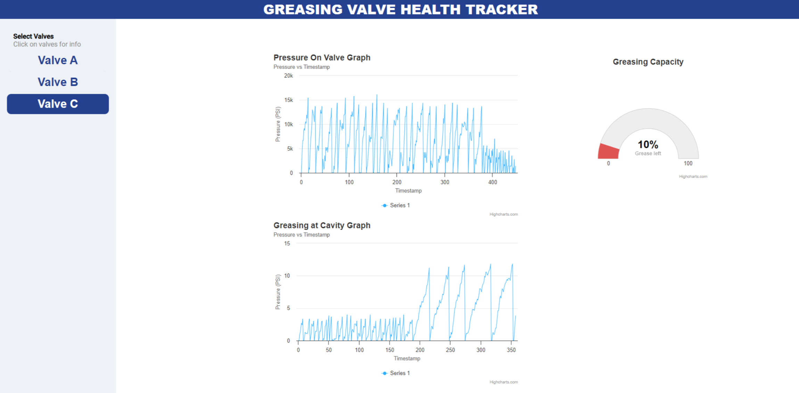
Scenario #3: Grease Spill / Leaking
Grease consumption vs Timestamp
Grease (L)

Slide 10
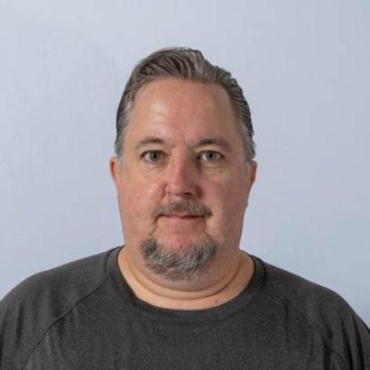
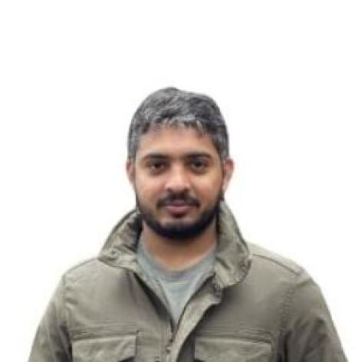
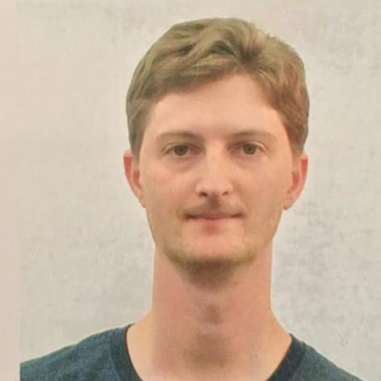
Teamwork!
Corey Ray
IIoT Hardware Technician
Vast Domain Knowledge
Problem Definition
Solution Validation
MVP
Architecture
Backend
Simulator
Frontend
User Experience
Devi Sai Shreyas Yakama
IIoT Software Engineer
VC internals knowledge
Diego Garziera Volpato
Back End Software Engineer

Slide 11
Future work
Migrate to Agora Gateway and Cloud
01
Select / Install Sensor (HCTC)
02
Enable valve mapping on ValveCommander
03

Slide 12

Thank you!
Questions?

